Slide 1
Final Project Development of an Image Classification System:
Involves creating an image classification system capable of processing a database of images, including high-quality and noisy images
Manasa Balaji Graduate student - M.S. in Data Science

Slide 2
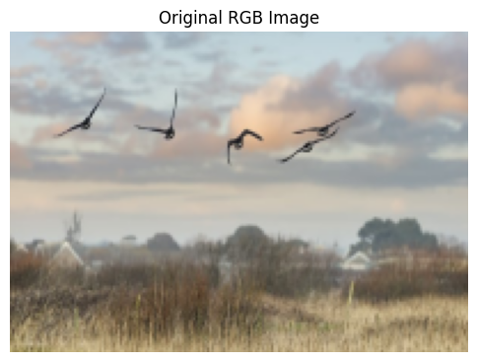
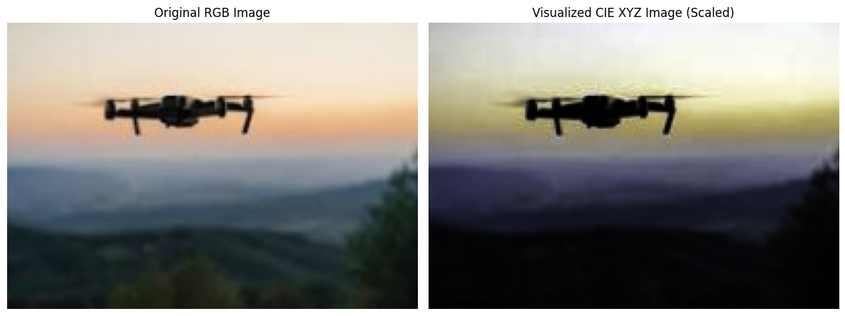
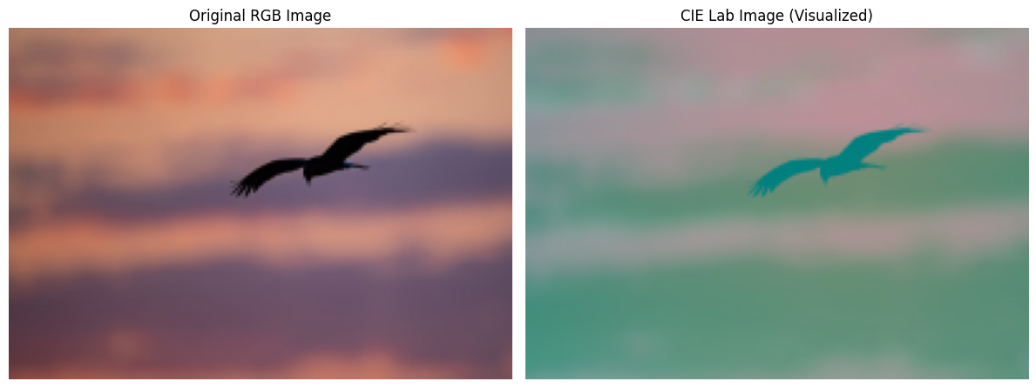
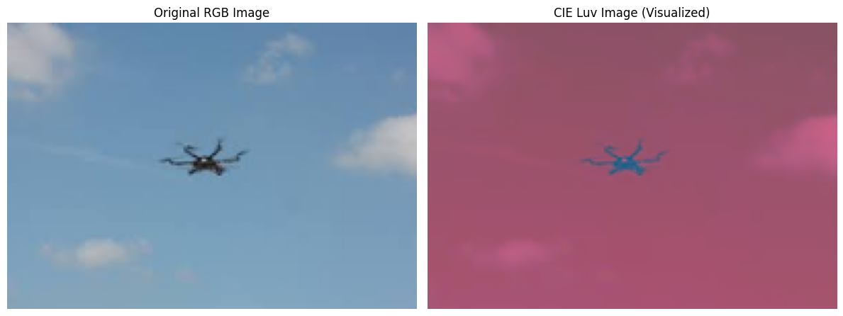
Project Idea: Bird vs. Drone Classification Using Image Filtering Techniques
In recent years, the growing use of drones in both civilian and defense applications has introduced new challenges in airspace monitoring and security. One of the critical challenges is accurately distinguishing between drones and birds in aerial or surveillance imagery, especially under varying environmental conditions such as daylight, nighttime, or weather-related noise. In this project my aim is to identify if an image has a bird or a drone in it.

Slide 3
Goals for this Assignment
1.Image Database Assembly: Compile a comprehensive image database, ensuring a mix of high-quality and noisy images to simulate real-world scenarios.
2. Image Restoration and Enhancement: Implement various image filtering techniques to enhance the quality of noisy images. Techniques such as denoising filters, deblurring, and histogram equalization should be considered.
3. Image Segmentation: Apply advanced image segmentation techniques to isolate objects of interest from the background.
4. Binary Object Feature Extraction: To segment the image further, take the best preprocessing ed-quality image by multiplying it with a binarized version.
5. Extract feature vectors using Binary Object Features – Projections as discussed in lectures 9-10.
6. Feature Vector Creation: Further construct feature vectors by computing Haralick Texture, Box Counting, Chain Code, and Local Binary Pattern histograms.
7. Concatenate these features to form a comprehensive feature vector for each image in the dataset.
8. Classifier Training: Using the feature vectors, train a Support Vector Machine (SVM) classifier.
9. Classification: Utilize the trained SVM to classify new images.
10. Evaluation of Classification Accuracy: Assess the accuracy of your classification system by calculating the proportion of correct predictions out of the total predictions. Multiply by 100 to convert this ratio to a percentage.
11. Documentation and Reporting: Thoroughly document each process step, from preprocessing to classification, including the rationale behind method selections and parameter tunings.
12. Report on the system's performance, discussing potential areas for improvement and how the system could be adapted for different applications.

Slide 4
Development of an Image Classification System
Image Database Assembly: Finding / Creating a dataset and preprocess the data
Image Restoration & Enhancement, check with scores
Apply segmentation algorithms and multiply with a binarized image
Concatenate these features to form a comprehensive feature vector
Construct feature vectors by computing Haralick Texture, Box Counting, Chain Code, and Local Binary Pattern histograms
Extract feature vectors using Binary Object Features
Train a Support Vector Machine (SVM) classifier
Utilize the trained SVM to classify new images
Evaluation of Classification Accuracy

Slide 5
Step 1: Data Loading and preprocessing
Load your database into MATLAB, Python, or a similar environment. Include a range of images: high-quality, low-light, blurred, and those with artificial or real noise introduced.
For the dataset, I used the Bird vs. Drone dataset from Kaggle: https://www.kaggle.com/datasets/stealthknight/bird-vs-drone/data
The dataset comprises a diverse collection of images, sourced from Pexel’s website, representing birds and drones in motion. These images were captured from video frames and are segmented, augmented, and pre-processed to simulate different environmental conditions, enhancing the model's training process.
This dataset contains about 900 images for the training data, which has split images of birds or drones. The data I used here was of about 450 images, containing both birds and drones. Also, I used a split of 80:20 for training and test data.
I added low-light to a few images, blurriness and
also added gaussian noise to some of the images.

Slide 6
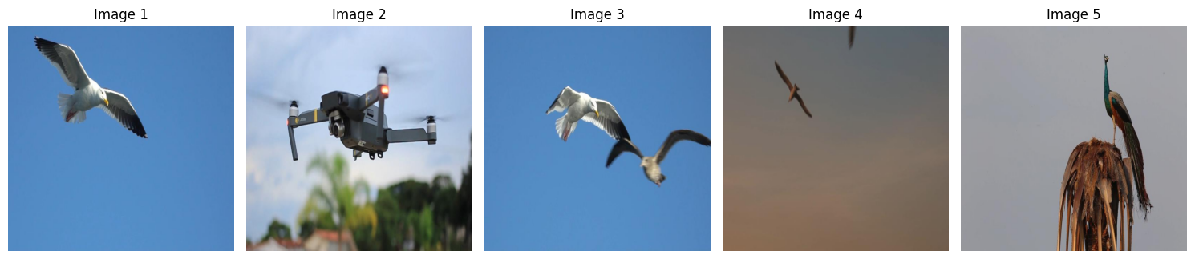
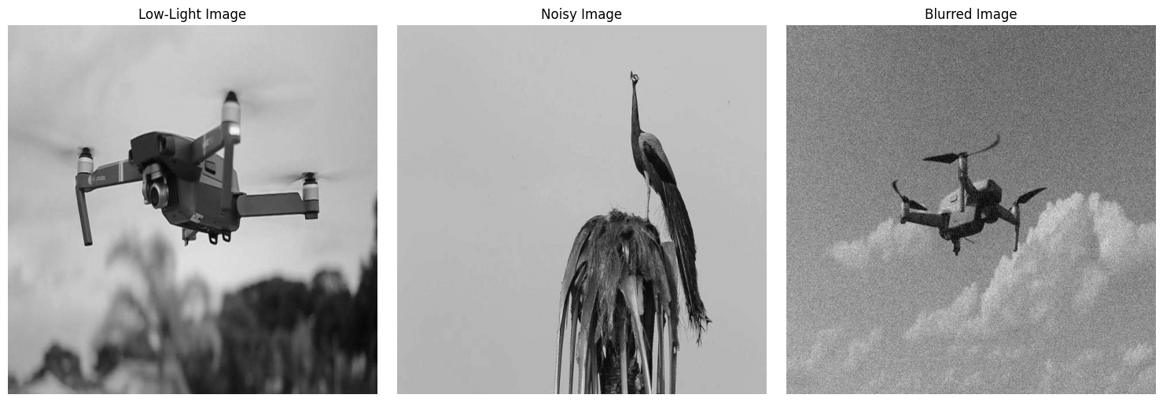
Original Images
Images after applying low-light, noisy, blur combinations. Images degraded using a single distortion setting that includes reduced brightness (0.7), Gaussian noise (mean = 0, sigma = 25), and blurring with a 25×25 kernel.

Slide 7
Step 2: Image Restoration and Enhancement
Implement various image filtering techniques to enhance the quality of noisy images.
For enhancing the image I used :
Histogram equalization
CLAHE
An average of these images was taken and was checked for noise levels.
Noise was present in most images, and it was predominantly Gaussian noise.
Hence I applied the Median filter to images with noise.
I tried applying the filter to all images (irrespective of whether they have noise, but it didn’t work well with images that didn’t have noise). So, I didn’t continue with this approach.

Slide 8
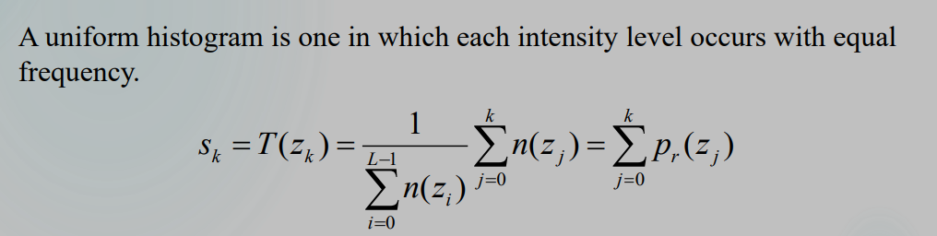
a. Histogram equalization Spreading out the frequencies in an image (or equalizing the image) is a simple way to improve dark or washed-out images. It can be expressed as a transformation of the histogram.
Where:
zkz_kzk​ → the k-th gray level in the original image.
sks_ksk​ → the new gray level after transformation (equalized intensity).
n(zj)n(z_j)n(zj​) → number of pixels with gray level zjz_jzj​.
LLL → total number of possible gray levels (e.g., 256 for 8-bit images).
pr(zj)=n(zj)∑i=0L−1n(zi)p_r(z_j) = \frac{n(z_j)}{\sum_{i=0}^{L-1} n(z_i)}pr​(zj​)=∑i=0L−1​n(zi​)n(zj​)​ → probability (normalized histogram) of gray level zjz_jzj​.

Slide 9
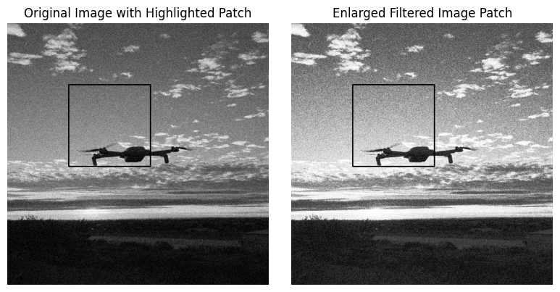
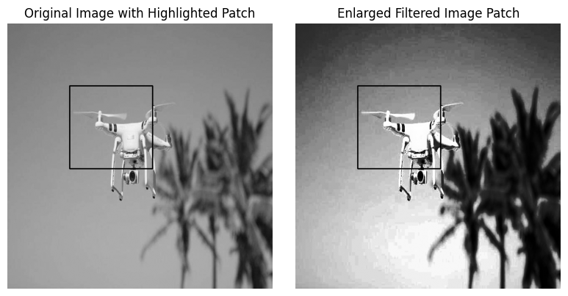
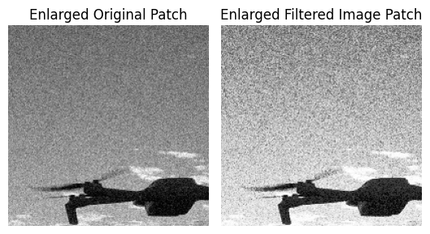
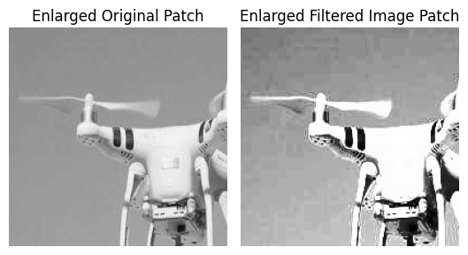
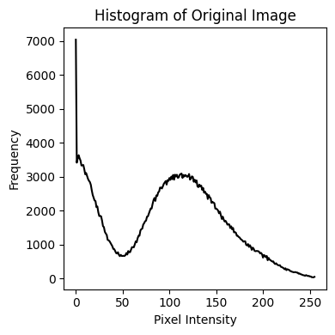
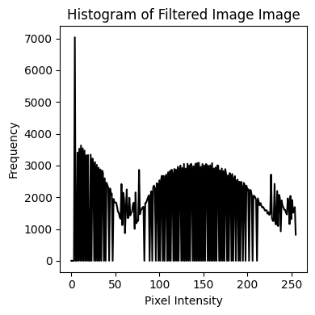
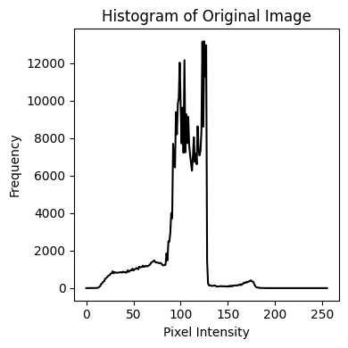
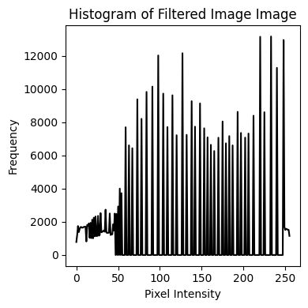
Histogram equalization

Slide 10
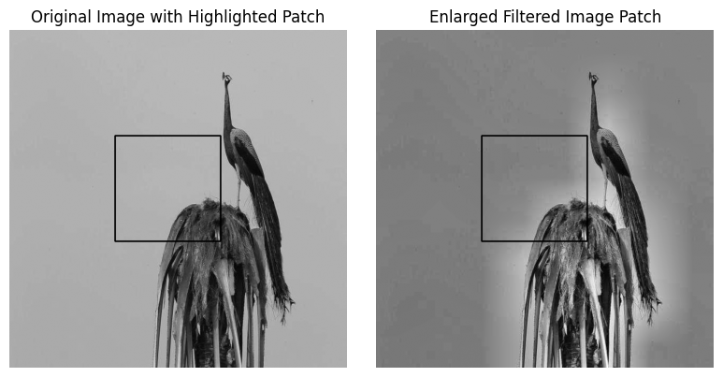
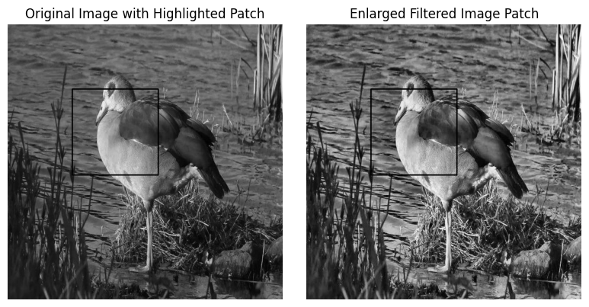
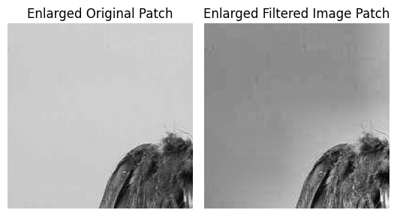
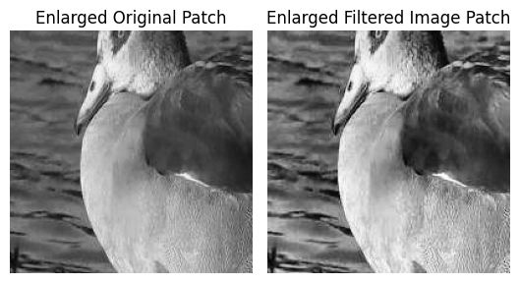
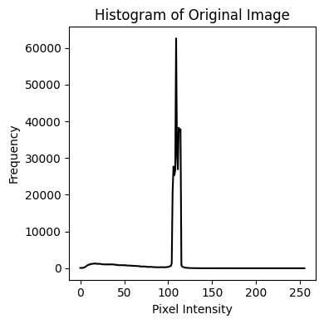
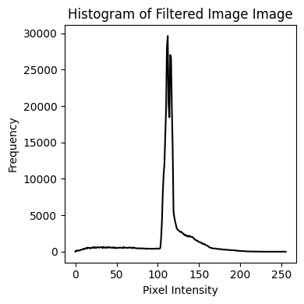
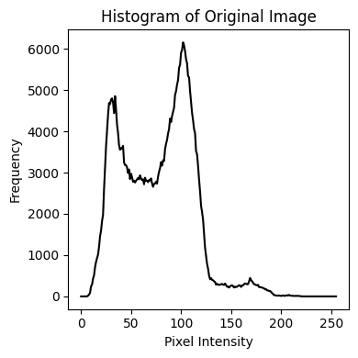
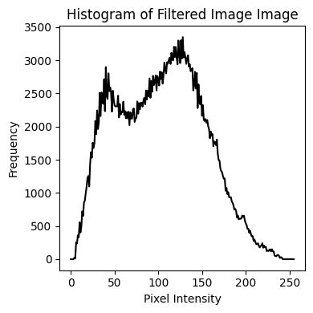
CLAHE

Slide 11
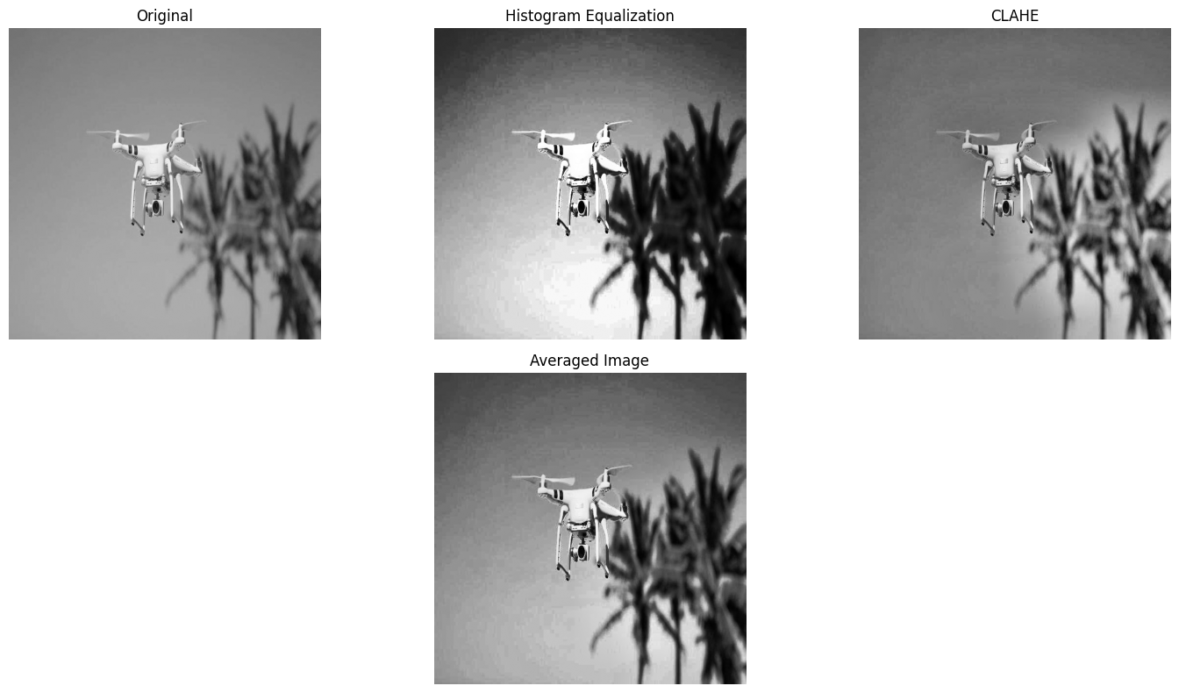
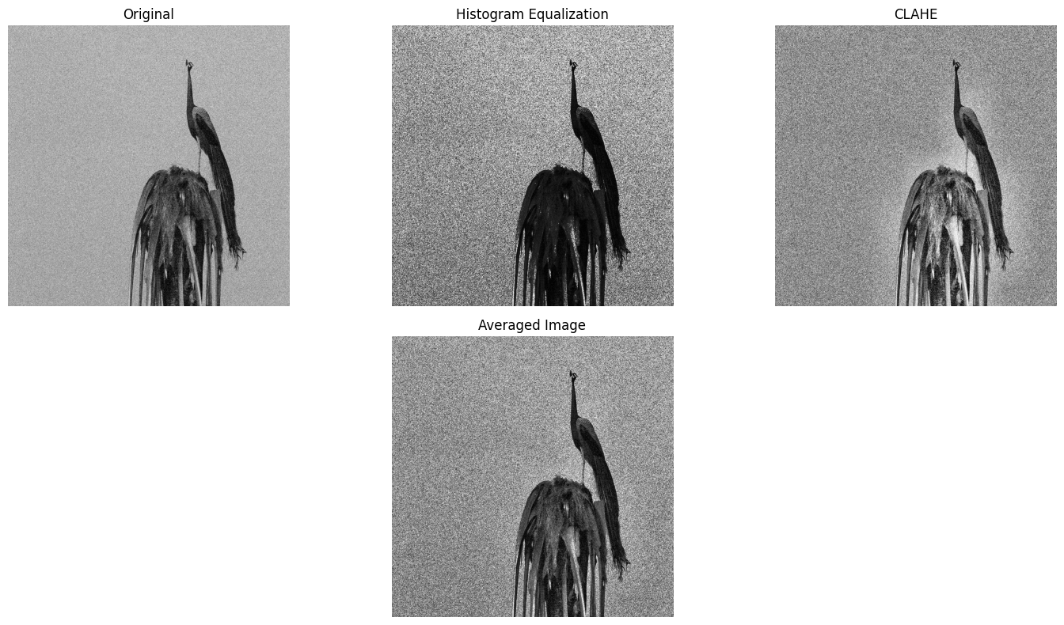
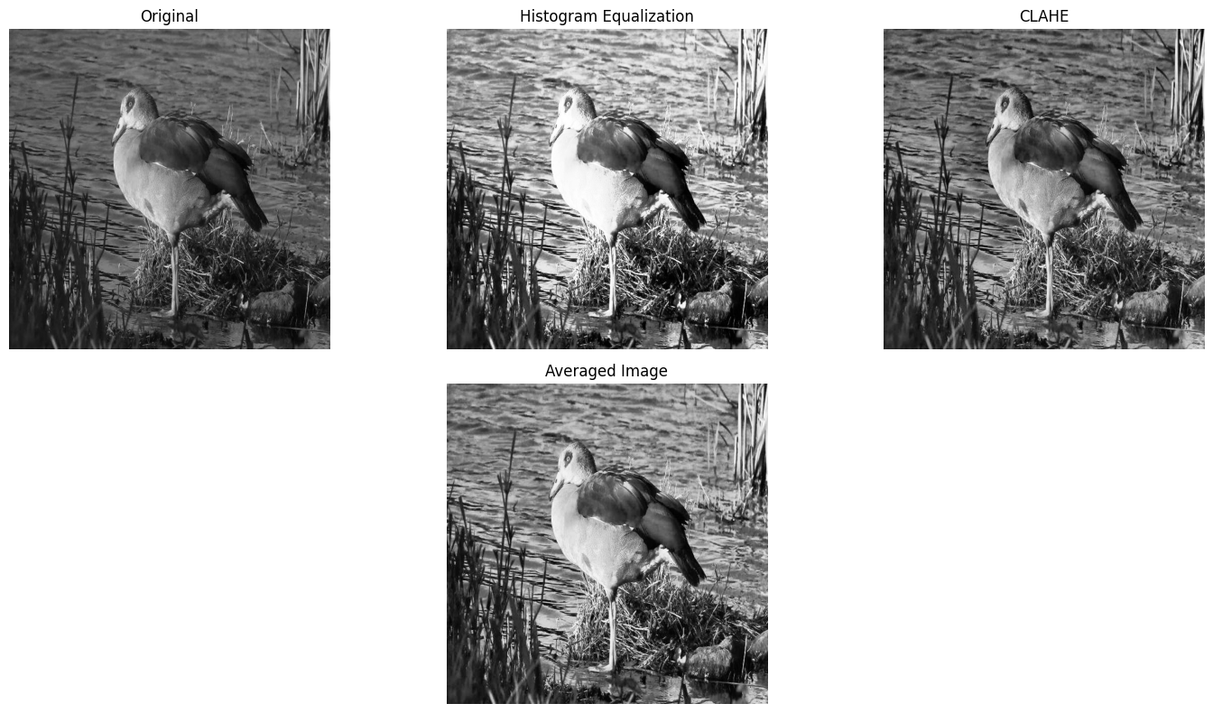
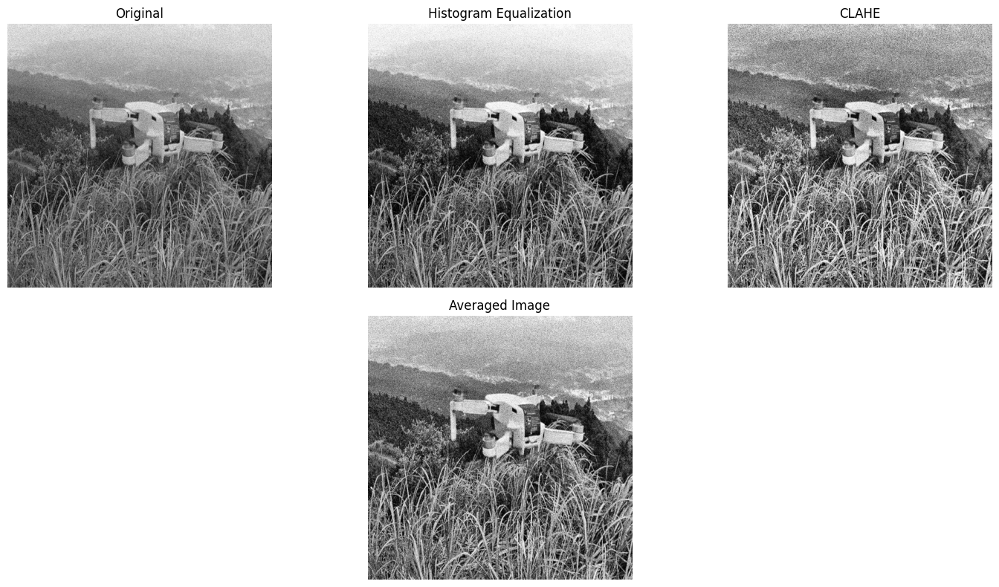
Averaged Image: Histogram Equ. + CLAHE / 2.0

Slide 12
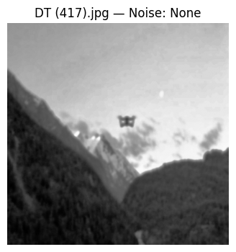
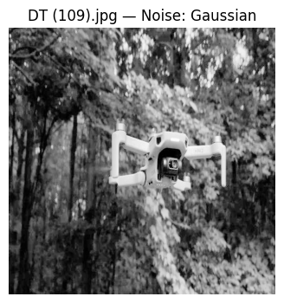
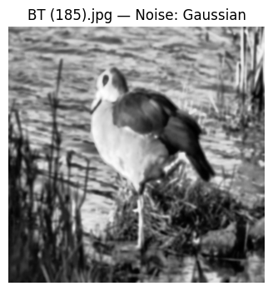
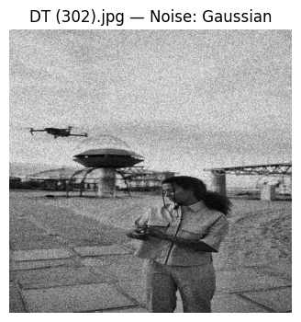
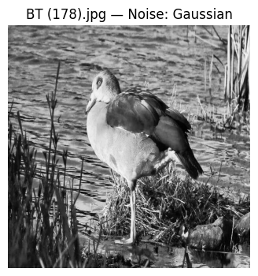
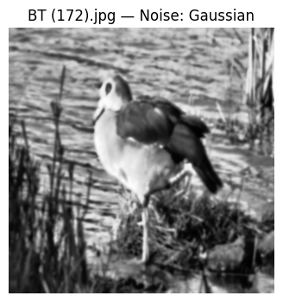
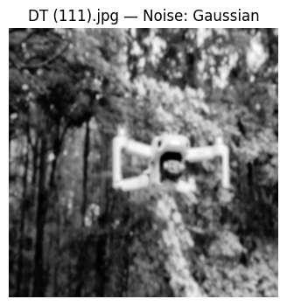
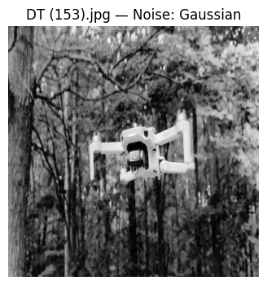
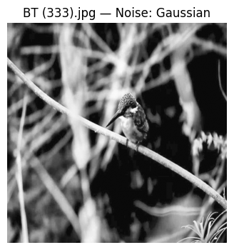
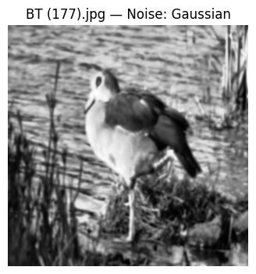
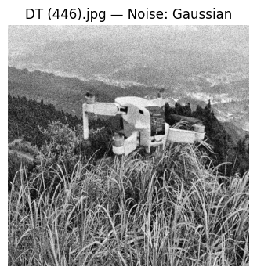
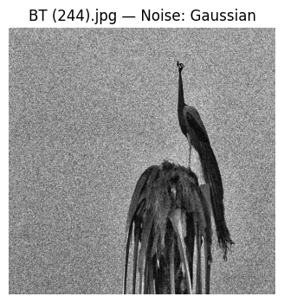
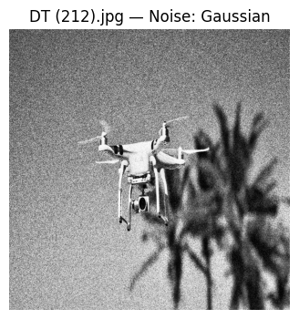
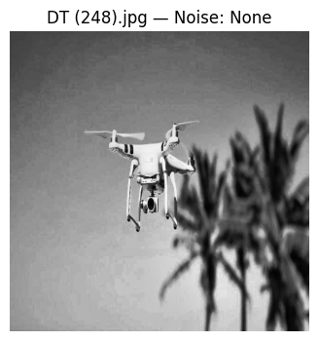
Estimating Noise

Slide 13
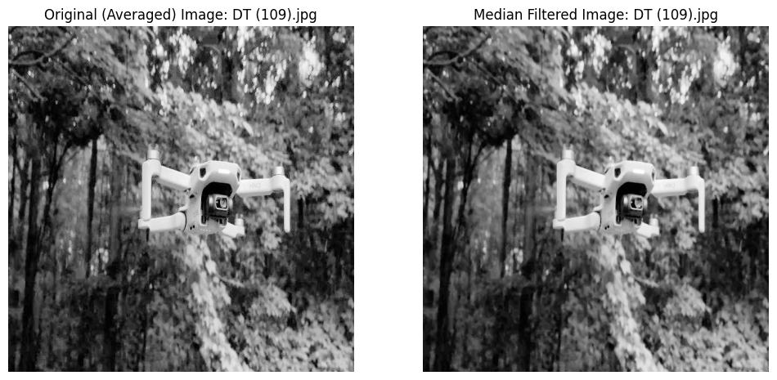
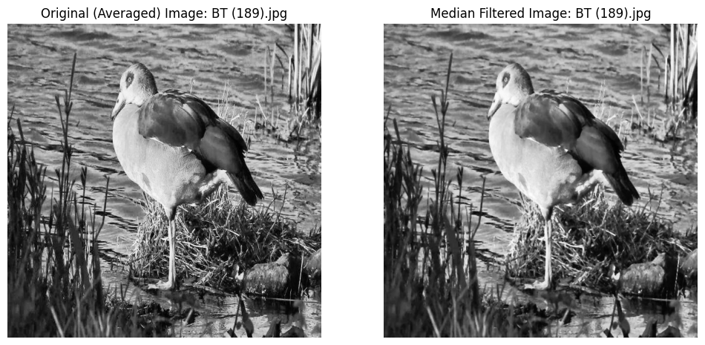
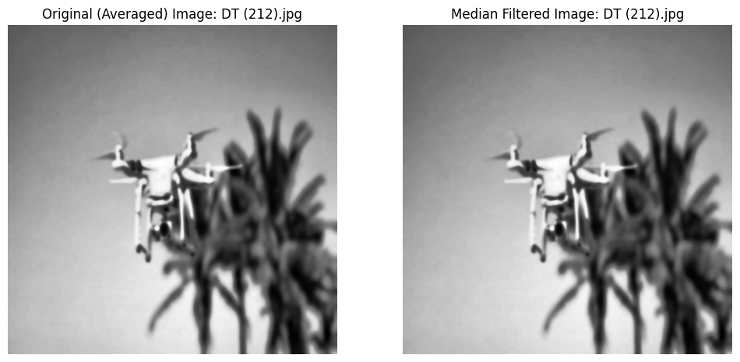
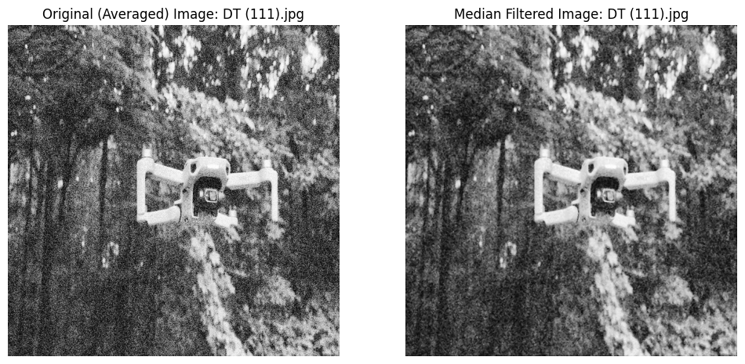
Median Filtered Images

Slide 14
Step 3: Image Segmentation
Apply advanced image segmentation techniques to isolate objects of interest from the background.
Steps and methods used here:
Otsu’s method for segmentation
Histogram based segmentation
Global Adaptive Thresholding
Apart from these, I tried using Morphological Opening by Reconstruction after applying Otsu’s method, and this gave me better results in removing the foreground object from the background.

Slide 15
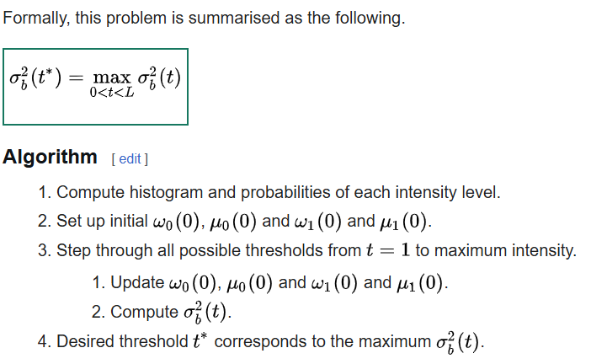
Otsu's method for segmentation
Otsu's method is a technique for automatic image segmentation that determines an optimal threshold to separate an image into two classes, typically foreground and background. It works by minimizing the variance within each class (within-class variance) or, equivalently, by maximizing the variance between the two classes (between-class variance). The method assumes the image histogram is bimodal (has two peaks) and works best when the two classes have significantly different pixel intensity values.
https://en.wikipedia.org/wiki/Otsu%27s_method

Slide 16
Histogram-based segmentation
Histogram-based image segmentation is one of the simplest and most often used segmentation techniques. It uses the histogram to select the gray levels for grouping pixels into regions. In a simple image there are two entities: the background and the object. The background is generally one gray level and occupies most of the image. Therefore, its gray level is a large peak in the histogram. The object or subject of the image is another gray level, and its gray level is another, smaller peak in the histogram.
Threshold Calculation:
Once the peaks are identified, the algorithm calculates thresholds between adjacent peaks. These thresholds help to segment the image into different classes:
T_i = (P_i + P_{i+1}) / 2 T_i represents the threshold value between the i-th peak and the (i+1)-th peak. P_i is the intensity value of the (i)-th peak P_i+1 is the intensity value of the adjacent (i+1))-th peak.
https://en.wikipedia.org/wiki/Thresholding_(image_processing)

Slide 17
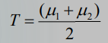
Global Thresholding Algorithm
The basic global threshold, T, is calculated as follows:
Select an initial estimate for T (typically the average grey level in the image)
Segment the image using T to produce two groups of pixels:
G1 contains pixels with grey levels >T and
G2 contains pixels with grey levels ≤ T
Compute the average grey levels of pixels in G1 to give μ1 and G2 to give μ2
Compute a new threshold value:
Repeat steps 2 – 4 until the difference in T in successive iterations is less than a predefined limit T∞, or e iterations do not change.
This algorithm works very well for finding thresholds when the histogram is suitable.
A global thresholding algorithm segments an image using a single threshold value for the entire image, classifying pixels as either foreground or background based on whether their intensity is above or below that value
https://en.wikipedia.org/wiki/Thresholding_(image_processing) Lecture Slides (Lecture 07) - Prof. Sos Agaian

Slide 18
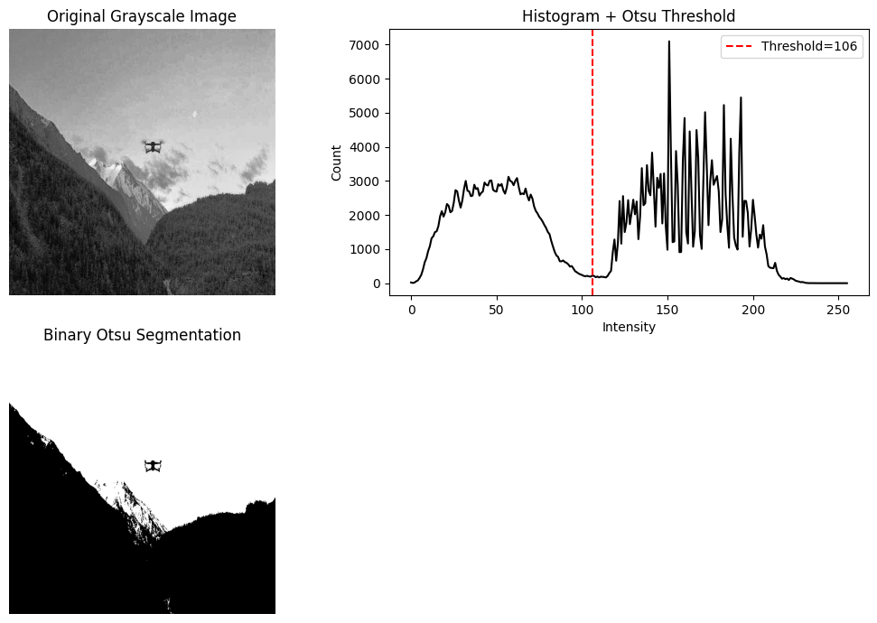
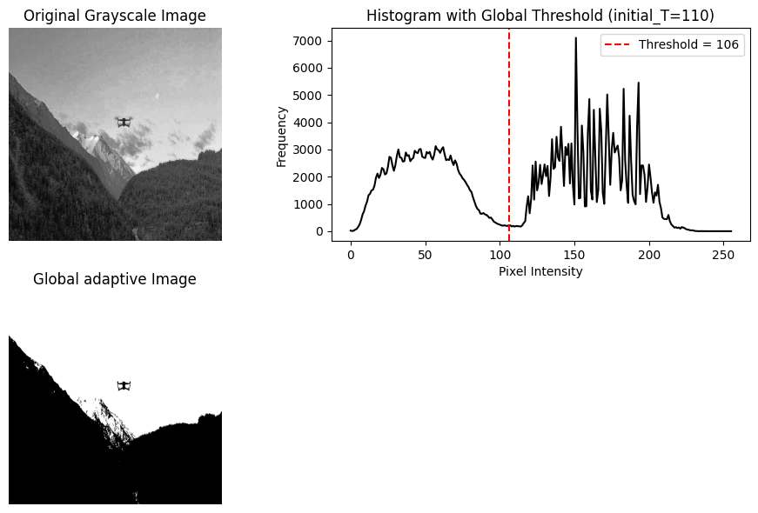
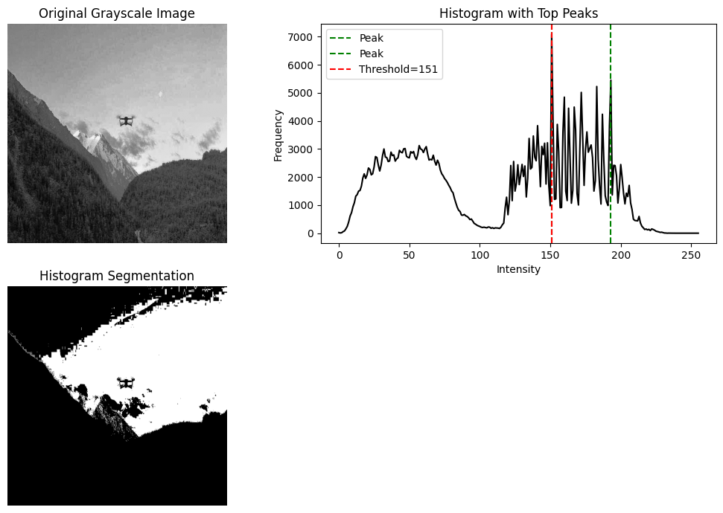

Slide 19






Slide 20
Morphological Opening by Reconstruction is an advanced image processing technique that first uses erosion to remove small objects (noise) and then uses geodesic dilation (reconstruction) to perfectly restore the shape and size of the remaining important objects, overcoming the imperfect restoration of standard opening (erosion then dilation). It's ideal for extracting objects of specific shapes (like tall letters) by preserving their true boundaries, unlike regular opening which can distort them.
How it Works (Step-by-Step)
Erosion (Marker Creation): An image is eroded with a structuring element (SE), shrinking objects and removing noise, creating a "marker" image.
Geodesic Dilation (Reconstruction): This is the key part, using two images:
Marker Image (F): The eroded image from Step 1 (the smaller, filtered version).
Mask Image (G): The original image (or a related image) that acts as a boundary, constraining the growth.
Process: The marker is repeatedly dilated (grown) using the SE, but only within the boundaries defined by the mask.
Result: The process stops when the dilated marker fills the entire shape of the original object in the mask, perfectly reconstructing it.
https://blogs.mathworks.com/steve/2008/07/14/opening-by-reconstruction/#:~:text=Today%20I%20want%20to%20show,is%20to%20use%20morphological%20reconstruction.

Slide 21





Slide 22
Step 4: Binary Object Mask
To segment the image further, take the best preprocessed quality image by multiplying it with a binarized version.
From the previous step, I decided to take the image we obtained from taking Otsu’s method, and then using the morphographic opening by reconstruction. This gave me better results in terms of keeping the bird/drone in the foreground and also removing as much background as possible.

Slide 23



Slide 24



Slide 25
Step 5: Extract feature vectors using Binary Object Features
Projections as discussed in lectures 9-10
Form Factor – Measures how close the shape is to a perfect circle based on area and perimeter.
Roundness – Indicates how circular an object is relative to its maximum diameter.
Aspect Ratio – Ratio between the longest and shortest dimensions of the shape.
Elongation – Describes how stretched or lengthened the object is.
Curl – Measures contour irregularity by comparing perimeter to major axis length.
Convexity – Ratio of convex-hull perimeter to actual perimeter; higher means smoother shape.
Solidity – Fraction of area filled relative to its convex hull; lower means more concave.
Compactness – Describes how densely the object’s area is packed relative to its diameter.
Modification Ratio – Ratio of inscribed circle diameter to maximum diameter, indicating uniformity.
Extent – Measures how much of the bounding box is occupied by the object.

Slide 26

Form Factor : 0.01424812958063281
Roundness : 0.40626122357358546
Aspect Ratio : 1.3752375679441629
Elongation : 1.0848896434634974
Curl : 21.301123572627144
Convexity : 0.15620252705368695
Solidity : 0.6522679426431592
Compactness : 292.1326189602883
Modification Ratio : 1.000000190706234
Extent : 0.556317531779661
--- Projection Features ---
Horizontal Projection Length: 640
Vertical Projection Length: 640

Slide 27

Form Factor : 0.007330901849910429
Roundness : 0.3047606651808375
Aspect Ratio : 1.354359461436014
Elongation : 1.0
Curl : 27.47664935097988
Convexity : 0.13436878635873964
Solidity : 0.501785054095719
Compactness : 234.10881867939338
Modification Ratio : 1.002853625823762
Extent : 0.439052734375
--- Projection Features ---
Horizontal Projection Length: 640
Vertical Projection Length: 640

Slide 28
Step 6: Feature Vector Creation
Further construct feature vectors by computing
Haralick Texture,
Box Counting,
Chain Code,
Local Binary Pattern histograms.

Slide 29

Extracted Haralick Features:
[ 5.45564236e-03 1.62094416e+02 9.38216348e-01 1.31137993e+03
7.02960004e-01 4.08099005e+02 5.08342530e+03 7.43011374e+00
8.40477536e+00 1.58099025e-03 1.94046245e+00 -7.01129324e-01
9.99940279e-01]
Contrast: 0.005455642360131989
Correlation: 162.09441577104434
Energy: 0.9382163475822142
Homogeneity: 1311.379929418279
ASM: 0.7029600038534207
Dissimilarity: 408.09900527818945
Entropy: 5083.425301902113
Inverse Difference Moment: 7.430113741976498
Max Probability: 8.404775360712533
Sum Average: 0.0015809902538921423
Sum Variance: 1.9404624456956139
Sum Entropy: -0.7011293238908444
Difference Entropy: 0.9999402791676844

Slide 30

Box Counting
Box counting in image processing is a core fractal analysis method to find an object's complexity (fractal dimension) by covering it with grids of different box sizes and counting occupied boxes, revealing how detail changes with scale, useful for texture analysis, shape classification, and understanding complex patterns like coastlines or biological structures. It involves superimposing grids (calipers), counting boxes containing image detail, and plotting log(count) vs. log(1/size) to find the slope, which is the fractal dimension.
How it works
Select Box Sizes: Choose a series of box sizes (calipers, s), from large to small (e.g., 100x100 pixels down to 1x1 pixel).
Superimpose Grid: Place a grid of the chosen size over the image.
Count Occupied Boxes (N): Count how many boxes contain any part of the foreground (e.g., black pixels for a binary image, or foreground pixels in grayscale).
Repeat: Repeat steps 2 & 3 for all chosen box sizes.
Plot & Calculate: Plot the natural logarithm of the count (ln(N)) against the natural logarithm of the inverse of the box size (ln(1/s)). The slope of this line is the fractal dimension (D). The Box-Counting Dimension is calculated by DB= [LogN(s)- LogN(s1)]/ [Logs - Logs1]
https://www.researchgate.net/figure/Example-of-the-box-counting-method-in-binary-images-The-binary-image-is-divided-into_fig1_326654292

Slide 31

Chain Code
A chain code algorithm in image processing is a method for representing the boundary of an object or shape as a sequence of directional codes. This representation efficiently encodes the contour information, making it useful for tasks such as shape analysis, feature extraction, and image compression.
Algorithm Steps:
Binary Image Preparation: The image containing the object of interest is typically converted into a binary image, where the object pixels are represented by one value (e.g., 1) and the background by another (e.g., 0).
Boundary Tracing:
Identify a starting point on the object's boundary, often the top-most, left-most pixel.
Traverse the boundary in a consistent direction (e.g., clockwise or counter-clockwise).
Directional Encoding:
At each step of the traversal, determine the direction of movement from the current pixel to the next boundary pixel.
Assign a numerical code to each direction based on a predefined scheme. Common schemes include:
4-directional chain code: Uses codes 0-3 for horizontal and vertical movements (e.g., 0 for right, 1 for up, 2 for left, 3 for down).
8-directional (Freeman) chain code: Uses codes 0-7, including diagonal movements in addition to horizontal and vertical ones.
Chain Code Generation: The sequence of directional codes generated during boundary tracing forms the chain code of the object.
https://www.sciencedirect.com/science/article/pii/S1047320315000206

Slide 32

Local Binary Pattern
Local Binary Pattern (LBP) in image processing is a simple, fast, and robust texture descriptor that encodes local image structure by comparing each pixel to its neighbors, creating a binary code representing texture patterns like edges, corners, and flat regions, which is highly effective for texture analysis, face recognition, and object detection due to its efficiency and resistance to lighting changes.
How LBP Works (Basic Example)
Neighborhood Selection: For a given center pixel, consider its 8 neighbors (a 3x3 window).
Thresholding: Compare each neighbor's intensity to the center pixel's intensity. If the neighbor is brighter or equal, assign '1'; if darker, assign '0'.
Binary Code: Concatenate these binary values (e.g., clockwise) to form a binary number (e.g., 10110010).
Decimal Conversion: Convert the binary string to a decimal number (e.g., 10110010 becomes 178).
Histogram: Compute the histogram of these decimal LBP codes across the entire image (or specific regions) to get a feature vector that describes the overall texture.
https://www.researchgate.net/figure/llustration-of-Local-Binary-Pattern-LBP_fig3_323057610

Slide 33


Slide 34

>>> Fractal Dimension (Box Counting):
Fractal Dimension: 1.7259736203611369
>>> Chain Code Histogram (8 directions):
[212 258 766 138 651 142 558 462]
>>> Local Binary Pattern Histogram:
[0.01104736 0.014729 0.00629639 0.02580811 0.01844971 0.080271
0.01469727 0.01884521 0.78281494 0.02704102]
>>> Shape Features:
area : 202747.0
perimeter : 3733.8358989953995
circularity : 0.18274851094576477
aspect_ratio : 1.4479638009049773
solidity : 0.9401603976786185
eccentricity : 2720064425.983269
>>> Haralick Feature Vector (13 values):
[ 2.35550706e-01 3.01898798e+02 9.79128643e-01 7.23242242e+03
8.32884637e-01 1.65685018e+02 2.86277909e+04 4.71637012e+00
5.58956577e+00 2.65734157e-03 1.52567228e+00 -6.71329070e-01
9.98189374e-01]

Slide 35
Step 7: Concatenate all features
Concatenate all these features to form a comprehensive feature vector for each image in the dataset. Iterate through each image in the dataset to assemble its complete feature vector.
Check if projection features exist (to avoid missing-data errors).
Retrieve previously computed features for the image from different dictionaries:
Horizontal & vertical projection features
Shape-based geometric features
Haralick texture feature vector (13 values)
Fractal dimension value
Chain code histogram (8 bins)
LBP histogram
Convert the shape feature dictionary into a fixed-order numeric vector to maintain consistency across images.
Concatenate all feature components into one long, unified feature vector per image.
Store the final feature vector together with the corresponding image name.
Print the total number of feature vectors created and the dimensionality of a sample vector.

Slide 36
Structure of the feature vector
1. Projection Features:
Horizontal Projection (H-proj), Length: image height
Each value = number of white pixels in that row
Vertical Projection (V-proj): Length: image width
Each value = number of white pixels in that column
2️. Shape-Based Geometric Features (6 values):
Extracted from the binary contour of the object:
Area
Perimeter
Circularity
Aspect Ratio
Solidity
Eccentricity
3️. Haralick Texture Features (13 values)
Computed from the gray-level co-occurrence matrix:
Contrast
Dissimilarity
Homogeneity
ASM
Energy
Entropy
Correlation
Cluster Shade
Cluster Prominence
And others (total = 13)
These describe texture complexity, smoothness, repetitiveness, and spatial patterns.
4️.Fractal Dimension (1 value)
From box counting method:
Measures boundary complexity / roughness.
5️.Chain Code Histogram (8 values)
Directional frequencies of contour movements (8-direction chain code):
Histogram bins: directions 0–7
Useful for capturing shape outline orientation.
6️.LBP Histogram
Local Binary Pattern texture descriptor:
histogram of uniform patterns
Captures local micro-texture.

Slide 37
Step 8 and 9: Classifier Training and Testing
Using the feature vectors, train a Support Vector Machine (SVM) classifier. Steps used: Extracts feature vectors and labels
Builds matrix X containing all final feature vectors.
Creates label vector y where:
1 = Drone (DT)
0 = Bird (BT)
Classification is therefore binary: bird vs drone.
Splits dataset into training and validation sets
Uses an 80/20 split.
stratify=y ensures equal proportion of birds and drones in both sets.
Helps evaluate the model on unseen data.
Builds an SVM classification pipeline
Applies StandardScaler() to normalize all features.
Trains an SVM with RBF kernel, which captures non-linear boundaries.
Trains the SVM model
Fits the pipeline (scaler + SVM) on the training data.
Learns the decision boundary that separates birds from drones.
Saves the trained SVM model to disk
Uses joblib.dump() to store the model as: svm_model_bird_vs_drone_final_features.pkl
Can later load the model for prediction without retraining.
Testing
Here we load the saved SVM model, predict labels for the validation feature vectors

Slide 38
[0 0 0 0 0 0 0 0 0 0 0 0 0 0 0 0 0 0 0 0 0 0 0 0 0 0 0 0 0 0 0 0 0 0 0 0 0
0 0 0 0 0 0 0 0 0 0 0 0 0 0 0 0 0 0 0 0 0 0 0 0 0 0 0 0 0 0 0 0 0 0 0 0 0
0 0 0 0 0 0 0 0 0 0 0 0 0 0 0 0 0 0 0 0 0 0 0 0 0 0 0 0 0 0 0 0 0 0 0 0 0
0 0 0 0 0 0 0 0 0 0 0 0 0 0 0 0 0 0 0 0 0 0 0 0 0 0 0 0 0 0 0 0 0 0 0 0 0
0 0 0 0 0 0 0 0 0 0 0 0 0 0 0 0 0 0 0 0 0 0 0 0 0 0 0 0 0 0 0 0 0 0 0 0 0
0 0 0 0 0 0 0 0 0 0 0 0 0 0 0 0 0 0 0 0 0 0 0 0 0 0 0 0 0 0 0 0 0 0 0 0 0
0 0 0 0 0 0 0 0 0 0 0 0 0 0 0 0 0 0 0 0 0 0 0 0 0 0 0 0 0 0 0 0 0 0 0 0 0
0 0 0 0 0 0 0 0 0 0 0 0 0 0 0 0 0 0 0 0 0 0 0 0 0 0 1 1 1 1 1 1 1 1 1 1 1
1 1 1 1 1 1 1 1 1 1 1 1 1 1 1 1 1 1 1 1 1 1 1 1 1 1 1 1 1 1 1 1 1 1 1 1 1
1 1 1 1 1 1 1 1 1 1 1 1 1 1 1 1 1 1 1 1 1 1 1 1 1 1 1 1 1 1 1 1 1 1 1 1 1
1 1 1 1 1 1 1 1 1 1 1 1 1 1 1 1 1 1 1 1 1 1 1 1 1 1 1 1 1 1 1 1 1 1 1 1 1
1 1 1 1 1 1 1 1 1 1 1 1 1 1 1 1 1 1 1 1 1 1 1 1 1 1 1 1 1 1 1 1 1 1 1 1 1
1 1 1 1 1 1 1 1 1 1 1 1 1 1 1 1 1 1 1 1 1 1 1 1 1 1 1 1 1 1 1 1 1 1 1 1 1
1 1 1 1 1 1 1 1 1 1 1 1 1 1 1 1 1 1 1 1 1 1 1 1 1 1 1 1 1 1 1 1 1 1 1 1 1
1 1 1 1 1 1 1 1 1 1 1 1 1 1 1 1 1 1 1 1 1 1 1 1 1 1 1 1 1 1 1 1 1 1 1 1 1
1 1 1 1 1 1 1 1 1 1 1 1 1 1 1 1 1 1 1 1 1 1 1 1 1 1 1 1 1 1 1 1 1 1 1 1 1
1 1 1 1 1 1 1 1 1 1 1 1 1 1 1 1 1 1 1 1 1 1 1 1 1 1 1 1 1 1 1 1 1 1 1 1 1
1 1 1 1 1 1 1 1 1 1 1 1 1 1 1 1 1 1 1 1 1 1 1 1 1 1 1 1 1 1 1 1 1 1 1 1 1
1 1 1 1 1 1 1 1 1]
Training complete. The SVM model has been saved as 'svm_model_bird_vs_drone_final_features.pkl'.

Slide 39
Step 10: Accuracy
Evaluation of Classification Accuracy: Assess the accuracy of your classification system by calculating the proportion of correct predictions out of the total predictions. Multiply by 100 to convert this ratio to a percentage.
[0 1 1 1 1 1 1 1 0 1 1 1 1 0 0 0 0 1 1 1 0 1 0 1 0 0 1 0 1 0 0 1 0 0 1 1 1
1 0 0 1 1 0 0 1 0 1 1 1 1 1 1 1 1 0 1 0 0 1 0 1 0 1 0 0 0 0 1 0 1 0 1 0 0
0 1 0 0 0 1 0 0 1 0 0 0 1 1 1 1 0 1 0 1 1 0 0 0 0 1 1 1 1 0 0 1 1 1 0 1 1
1 0 1 1 1 1 1 1 0 1 0 1 0 0 1 1 0 1 1 1 0 0 1 1]
Classification Accuracy on Validation Set: 98.52%
[1 0 0 1 1 1 0 1 1 0 1 1 1 1 0 1 1 1 1 1 0 1 1 0 0 0 0 1 1 1 0 1 1 0 0 0 0
1 1 1 0 1 0 0 1 1 1 0 0 1 0 0 1 0 1 1 1 0 1 0 1 0 1 0 1 1 1 1 1 1 0 1 1 1
0 1 0 1 0 1 1 0 1 1 1 0 0 0 1 1 1 0]
Classification Accuracy on Validation Set: 97.83%

Slide 40
Conclusion
The project successfully utilized image preprocessing techniques such as histogram equalization and CLAHE to enhance image quality, especially in noisy environments. The application of Median filtering helped mitigate Gaussian noise in the images, ensuring better input quality for further processing.
Advanced segmentation techniques like Otsu’s method, histogram-based segmentation, and global adaptive thresholding were employed to isolate the bird and drone from the background. Morphological Opening by Reconstruction further improved the segmentation results, enhancing the foreground object extraction.
The SVM classifier was trained and tested with the segmented images, demonstrating its capability in distinguishing between birds and drones. However, there is potential to further enhance the accuracy and robustness of the classifier.

Slide 41
Future work
Deep Learning Approaches: A potential area for improvement is to transition from traditional machine learning techniques like SVM to deep learning models. Convolutional Neural Networks (CNNs) can be trained end-to-end, learning both feature extraction and classification tasks simultaneously. This can significantly improve accuracy, especially in handling complex or noisy datasets.
Data Augmentation: Implementing data augmentation techniques such as rotation, flipping, and scaling can increase the dataset size and variability, enhancing model generalization.
Transfer Learning: Leveraging pre-trained models such as VGG16 or ResNet can speed up training and improve the classifier's performance by using knowledge from a vast amount of labeled data.
Real-time Classification: Moving forward, the system can be optimized for real-time classification by utilizing more efficient deep learning models, possibly with the help of GPU acceleration for faster processing.

Slide 42
References
Prof. Sos Agaian, Lecture Slides, Computer Vision
https://www.kaggle.com/datasets/stealthknight/bird-vs-drone/data
https://en.wikipedia.org/wiki/Otsu%27s_method
https://blogs.mathworks.com/steve/2008/07/14/opening-by-reconstruction/#:~:text=Today%20I%20want%20to%20show,is%20to%20use%20morphological%20reconstruction.
https://blogs.mathworks.com/steve/2008/07/14/opening-by-reconstruction/#:~:text=Today%20I%20want%20to%20show,is%20to%20use%20morphological%20reconstruction
https://en.wikipedia.org/wiki/Otsu%27s_method
https://en.wikipedia.org/wiki/Thresholding_(image_processing)
https://www.researchgate.net/figure/Example-of-the-box-counting-method-in-binary-images-The-binary-image-is-divided-into_fig1_326654292
https://www.sciencedirect.com/science/article/pii/S1047320315000206
https://www.researchgate.net/figure/llustration-of-Local-Binary-Pattern-LBP_fig3_323057610

Slide 43
END OF PRESENTATION

